Slide 1

SMART HOME PROJECT
MEMBERS:
MALEK ESSAM
MAZEN MOKBEL
MOHAMED AYMAN
YOUSSEF ALI
YOUSSEF GALAL
YOUSSEF KHALED

Slide 2
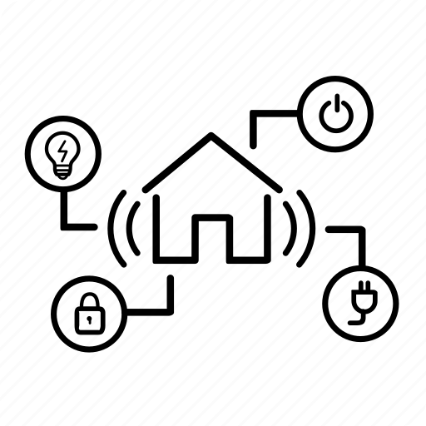
INTRODUCTION
Benefits of Smart Homes:
A smart home means giving your home a system that connects with your appliances to automate specific tasks and is typically remotely controlled. You can use a smart home system to program your locks for security, air conditioning and heating, light control, information display and alerts.
These functionalities are accessed remotely by the Admin(s) via their phone(s) using Bluetooth or on-site by the users using the keypad.

Slide 3


PROBLEM STATEMENT
With all the technological advancements in our generation it is only rational to expect that with more inventions, hardware, and software programs/applications there will be either security breaches or lack of keeping in touch with everything around us, this introduces an opportunity to create a system for monitoring and providing an ease of access to these applications.

Slide 4

TECHNOLOGIES USED
Software(s) Used:
Proteus Design Suite
IDE: Eclipse
Bluetooth Serial Controller

Slide 5
DESIGN AND SIMULATION SETUP
Modules: brief description of each module
LCD:
  Used as one of the key components for the login system and system control, its mostly only used by the users, it also displays the running devices in the background if it’s not used by the user
Keypad:
  Used by the user to both log in and interact with the system, therefore it acts as the control hub of the system.
Relay:
  A relay is a device that responds to a small current or voltage change by activating a switches or other devices. Used to remotely switch signals or power
Bluetooth:
  Is used for establishing a connection between the system and the admin’s phone for system access and controls.

Slide 6
DESIGN AND SIMULATION SETUP CONT.
AC Controller: Is turned on/off based on the temperature sensor’s readings.
Temperature Sensor: Temperature sensor reads the ambient temperature, if the temperature is higher than 28°C, Air condition must be run “DC motor”, if the temperature becomes lower than 21°C, Air condition must be turned off “DC motor”.
Alarm: Is a security measure that’s triggered upon multiple false login entries.
Lamps: Lamps are isolated because of high power.
Door Controller: The actuator used is a servo motor to control the opening door only in admin mode, it is controlled by command which is send by Mobile/PC “Open Close the door”.

Slide 7
Flow Chart
Login
If Admin Go to location 101 and compare between Admin Username Entry Array and EEPROM
Same as to Password
If User use for loop for location
Location = counter to number of users * 7
Compare entries in each loop
If matches any user ID save value of counter for Password Check
Password Mapping = counter * 7 + 3
Admin is @ 101
Adding Users
1 byte for number of users @ 100
3 bytes for each user ID
4 bytes for each user Password
For adding users (mapping) = (Number of users * 7)
After adding user in an array check if it already exists in
EEPROM if valid print valid ID
start
Keypad Entry
Save Entries in Array
Compare Entries with EEPROM

Slide 8

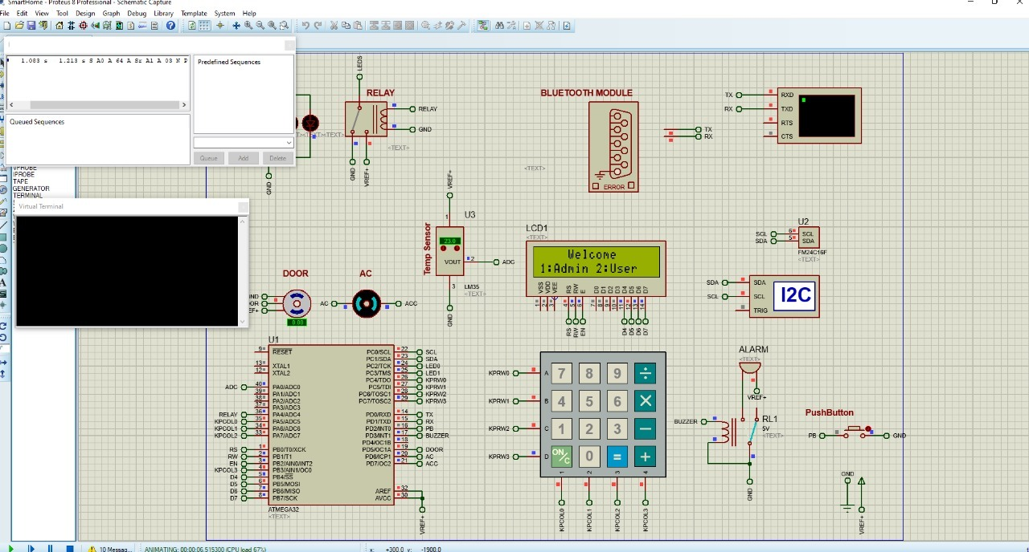

Slide 9
THANK YOU

